Slide 1
AI-BASED DIABETES PREDICTION SYSTEM
NAME : K.MONISHA
EMAIL ID : kmonisha560@gmail.com
NM ID :au513521104027
DEPT : BE(CSE) III YEAR

Slide 2
Introduction:
Diabetes is a disease that directly affects the pancreas and the body is incapable of producing insulin. Insulin is mainly responsible for maintaining the blood glucose level.
Many factors such as excessive body weight, physical inactivity, high blood pressure, and abnormal cholesterol level can cause a person get affected by diabetes.
According to IDF(International Diabetes Federation) statistics, 537 million people had diabetes around the world in 2021.In Bangladesh, approximately 7.10 million people had suffered from this disease, according to 2019 statistics.
This work used four types of kernels, linear, polynomial, RBF and sigmoid to predict diabetes in the machine learning platform. The authors obtained diverse accuracies in different kernels, ranging between 0.69 and 0.82.
The SVM technique with radial basis kernel function obtained the highest accuracy of 0.82.

Slide 3
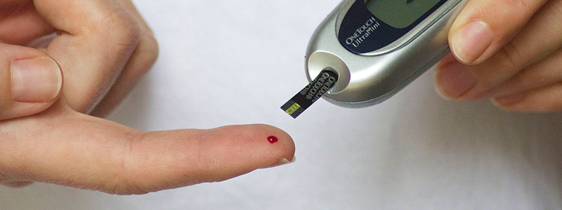
Highlight:
The goal of this work is to find effective machine learning based classifier models for detecting diabetes in individuals utilizing clinical data.
The results of this study suggest that an appropriate preprocessing pipeline on clinical data and applying ML-based classification may predict diabetes accurately and efficiently.
Based on the observed results, a smart web application is developed for predicting the diabetes accordingly.
Abstract:
Diabetes is very common disease affecting individuals worldwide. Diabetes increases the risk of long term compilcations including heart disease and kidney failure among others. People might live longer and lead healthier lives if this disease is detected early.
Different supervised machine learning models trained with appropriate datasets can aid in diagnosing the diabetes at the primary stage.
The results of this study suggest that an appropriate preprocessing pipeline on clinical data and applying ML-based classification may predict diabetes accurately and efficiently.

Slide 4
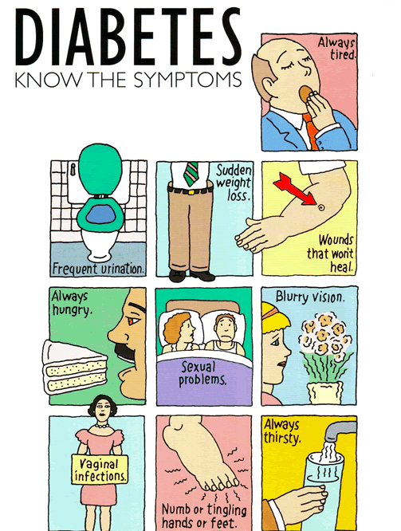
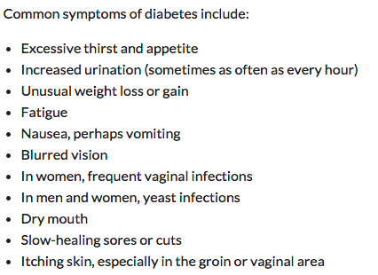
Symptoms of Diabetes:

Slide 5
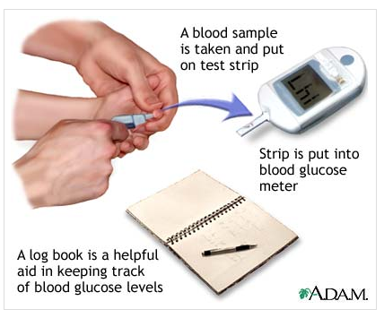
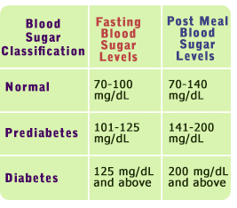
How to monitor your diabetes:

Slide 6
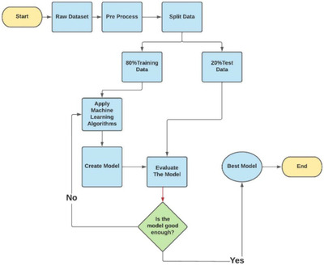
Proposed system:

Slide 7
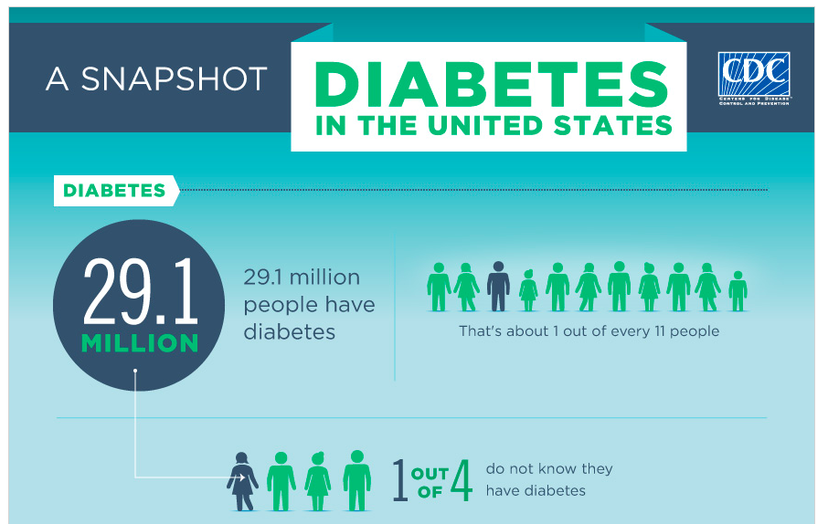
U.S. Prevalence:
Notes:
http://www.cdc.gov/diabetes/home/

Slide 8
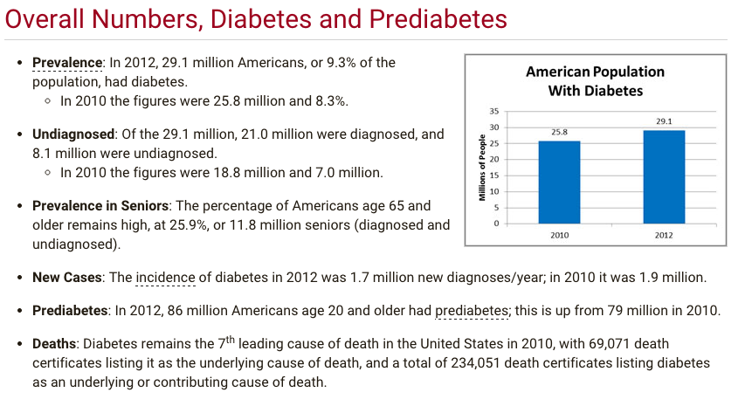
U.S. Prevalence:
Notes:
http://www.cdc.gov/diabetes/home/

Slide 9
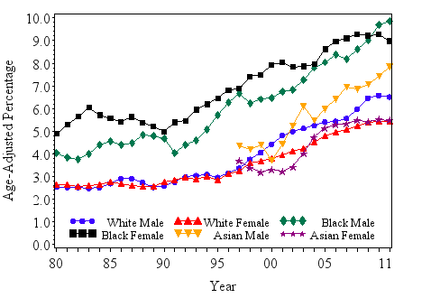
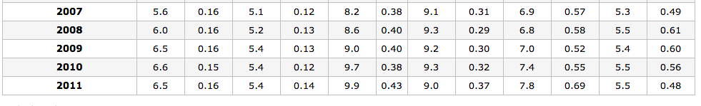

Slide 10

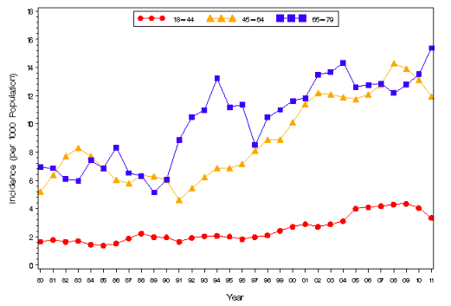

Slide 11

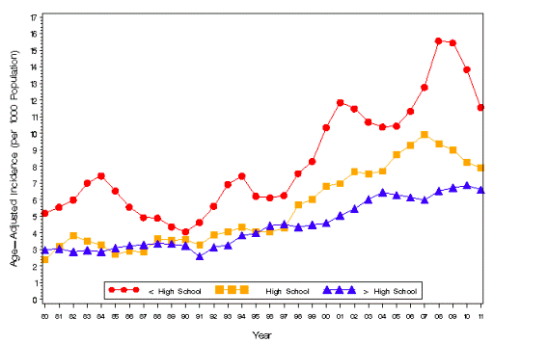
Notes:
Where do we begin to educate?

Slide 12
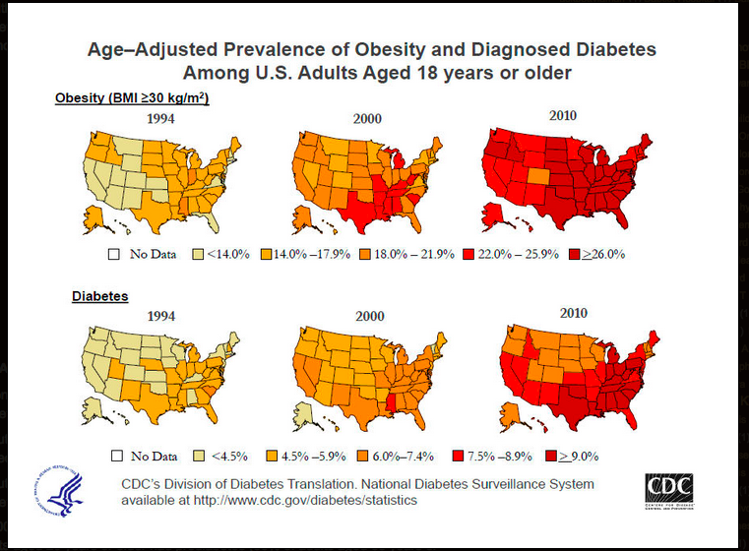

Diabetes and Obesity:
Notes:
Strong correlation, but not necessarily the cause of type II.

Slide 13
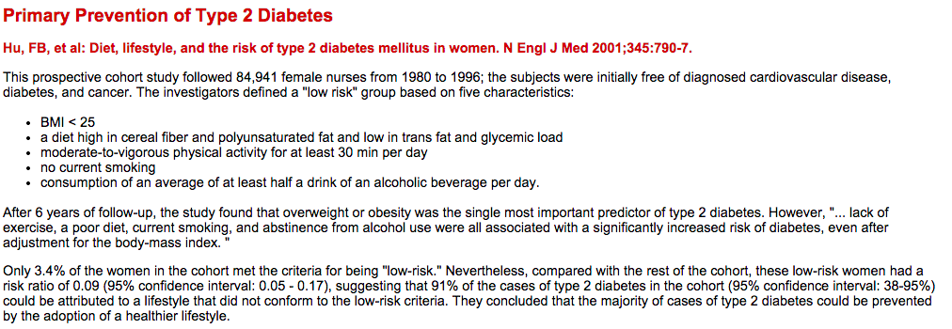
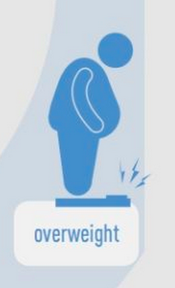
Research:
Notes:
84, 941 subjects with no CVD, diabetes or cancer – case study over 6 years
overall healthy subjects
overall finding: * overweight/obesity was the single most important predictor of type 2 diabetes and those who adopted a healthy lifestyle did not develop diabetes.

Slide 14
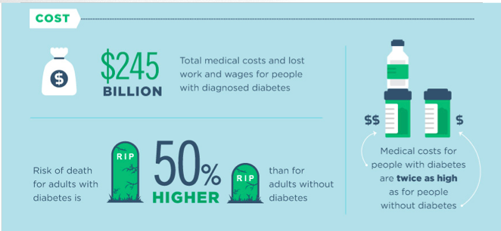
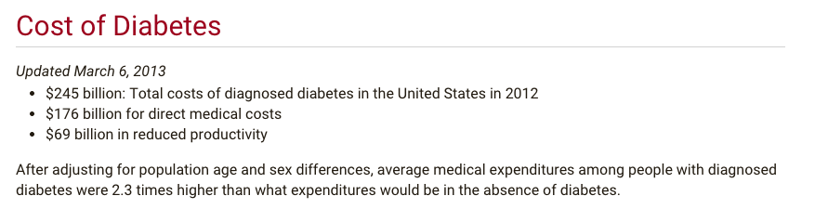
Cost of Diabetes (US):

Slide 15
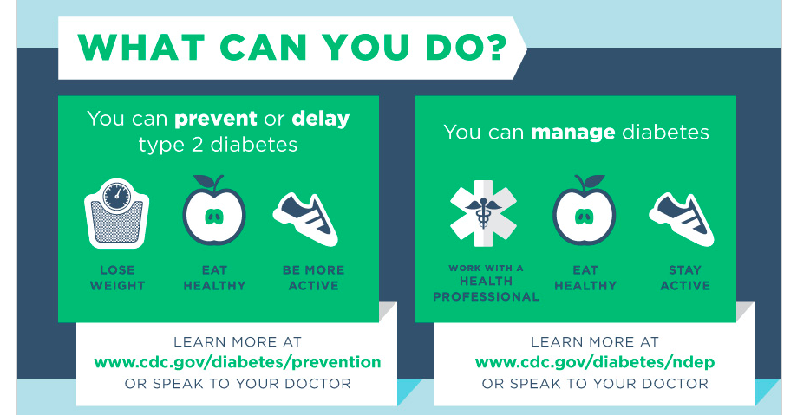

Slide 16
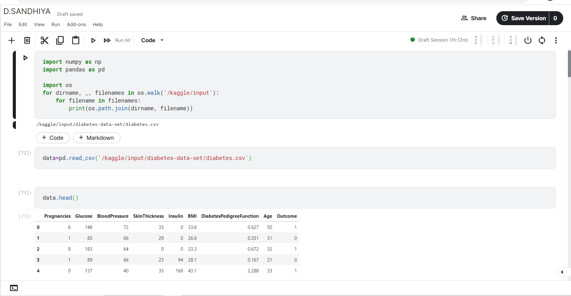
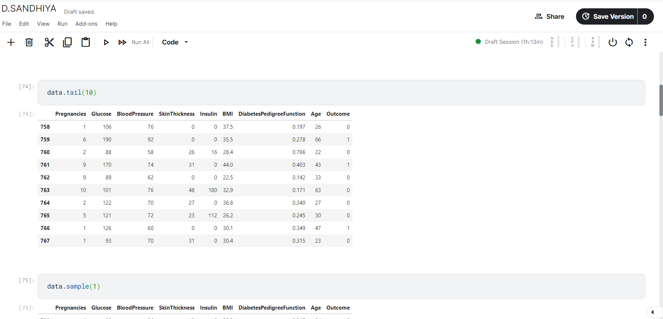
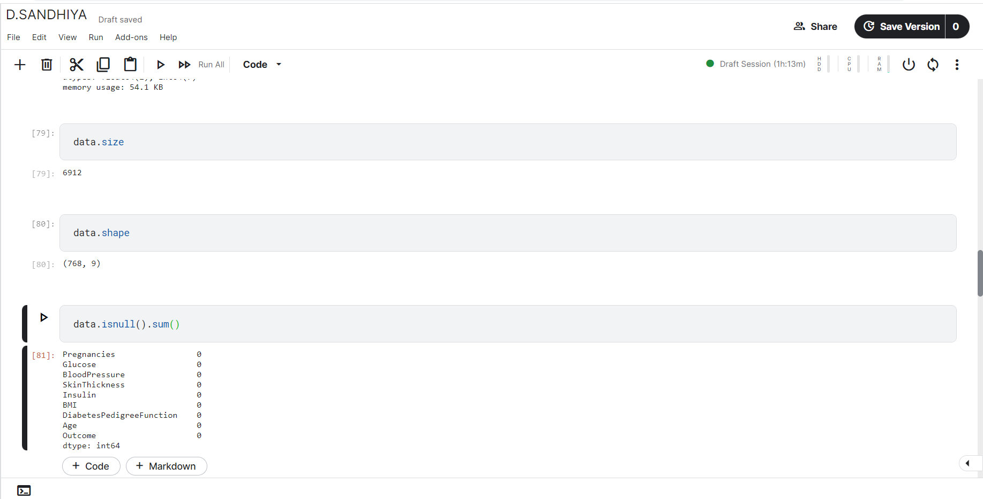
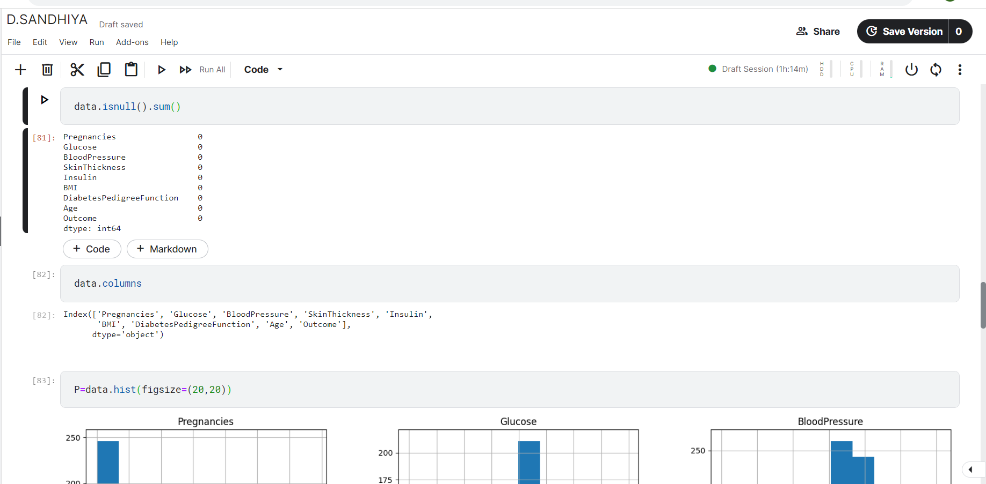
output

Slide 17
Diabetes prediction
Prediction model
Enter body mass index
28.10
Enter insulin
94
Enter glucose
89
Enter your age
21
predict
The person has diabetes

Slide 18
The link
https://www.kaggle.com/code/dsandhiya/d-sandhiya/edit

Slide 19


